Slide 1
North Carolina
Technician Safety Equipment Inspection Program
Safety Equipment
Certification Course
Inspection Procedures

Slide 2
Opening Statement
There are approximately 38,000 certified Inspection Mechanics performing state safety inspections at over 6,200 Official Inspection Stations in North Carolina. These inspections, when performed properly, help ensure the safety of vehicles traveling upon our highways by removing unsafe motor vehicles. These unsafe vehicles may not renew their registration until the identified deficiencies are corrected. If these inspections were not required, drivers could be operating vehicles upon the roads and highways of our state with potential hazards that could jeopardize the safety of themselves and fellow motorists. To prevent this, the State of North Carolina enacted legislation in 1964 requiring motor vehicles registered in this state to be inspected for safety equipment compliance on an annual basis.

Slide 3
Course Objective
At the end of this block of instruction, the student will be able to achieve the following objectives in accordance with the information received during the instructional period.
1. List the eleven inspection areas inspector mechanics must check during a
safety inspection.
2. Identify safety items required for a NC Safety Inspection.
3. Determine what emissions control devices are required on a vehicle during
a safety test by using the Emission Control System Applications Manual.
4. Calibrate and utilize a headlight aimer.
5. Test and utilize a window tint meter.
6. Achieve a score of 80% or higher on a Division approved written exam.

Slide 4
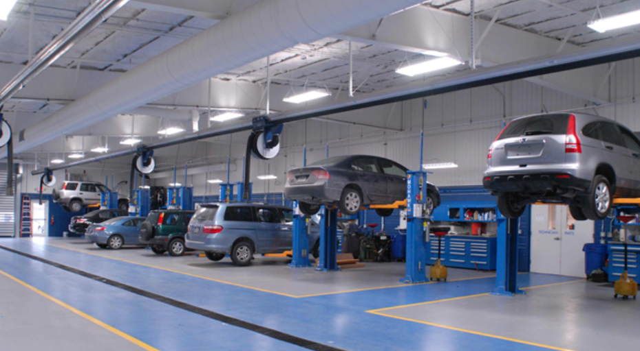
.0519 Station Qualifications
An inspection station is a place of business legally licensed by the DMV Commissioner to conduct inspections of motor vehicles as required by North Carolina General Statute. Each Inspection Station must be equipped with the proper equipment and tools to perform inspections, which includes the following.
(1) One jack or lift with a minimum capacity of two tons.
One headlight tester to fit all headlights.
(Mechanical, optical, or wall chart)
(3) One workbench.
One creeper.
One tire tread depth gauge
(calibrated in 32nds of inch).

Slide 5
.0519 Station Qualifications
Emissions Control Systems Application Manual or current
computerized electronic software.
(7) One approved Analyzer with current software or approved
computer for Web Safety access.
Analog connections will no longer be available after June 30, 2024. All analyzer connections will have to be through a VPN internet-based connection. Analyzers using Analog / Dial Up connections will not be able to conduct and transmit inspections after June 30, 2024. Station applications received after January 1, 2024, will require a VPN internet-based connection for approval.
One active dedicated telephone line with internet access for Web Safety.
Note : Each licensed inspection station should display the Official Safety and
OBD Procedure Posters, station license and fee chart in the waiting room or
at the cash register where customers can see them.

Slide 6
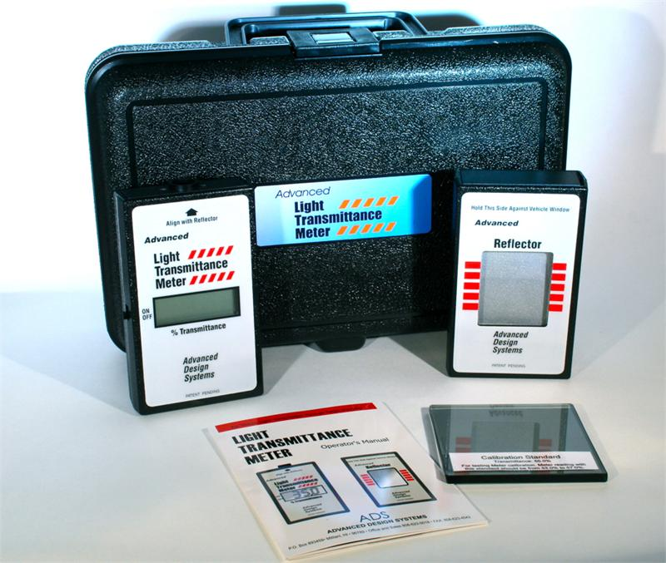
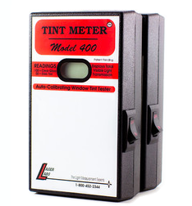
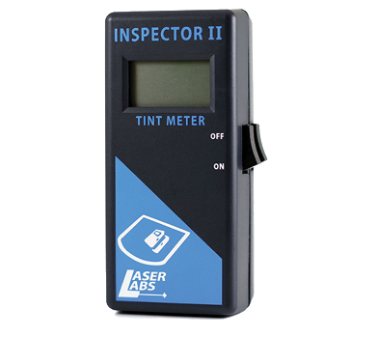
Additional Equipment
Inspection stations are not required to conduct inspections on vehicles equipped with after factory window tint. However, if inspections are conducted on these vehicles, the inspection station must have the following optional equipment.
One Approved Window Tint Tester
(with undamaged reference glass sample)

Slide 7
Inspection-Mechanic
To obtain certification to perform North Carolina Safety Inspections the prospective technician must meet all of the following requirements for initial and continued certification:
Attend and pass an eight-hour Approved Safety Inspection Course offered by a North Carolina Community College and pass a written examination with a score of no less than 80 percent correct answers. No oral exams shall be allowed.
Have a driver’s license that is Valid In North Carolina.
Be of good character and have a reputation for honesty be able to successfully pass a background check as required by the Division.
(Applicants that are denied licensing because of prior criminal history will have the opportunity to schedule a hearing with the Office of Administrative Hearings to request reinstatement)
The license of a Safety Inspector-Mechanic expires every 4 years.

Slide 8
Inspection Fees
The fee for performing an inspection of a vehicle applies when an inspection is performed, regardless of whether the vehicle passes the inspection. The fee for an electronic inspection authorization applies when an electronic inspection authorization is issued to a vehicle. No taxes or shop fees can be added to the inspection cost.
Type Inspection Authorization Total
S/I $12.75 $ .85 $13.60
I/M $23.75 $6.25 $30.00
The fee for inspecting after‑factory tinted windows shall be ten dollars ($10.00), and the fee applies only to an inspection performed with a light meter after a safety inspection mechanic determined that the window had after‑factory tint.
A safety inspection mechanic shall not inspect an after-factory tinted window of a vehicle for which the Division has issued a medical exception permit pursuant to G.S. 20-127(f).

Slide 9
Vehicles Currently Subject to a Safety Inspection Only
All Vehicles that are within the three most recent model years AND have LESS THAN 70,000 miles.
All Vehicles newer than 30 years old (Date manufactured)
All Vehicles with Farm Tags.
Electric / Plug in Vehicles.(Does not have the ability to be propelled
by gasoline or diesel fuel)
Trailers with a gross weight of 4,000 pounds or more.
Vehicles with a GVWR of more than 8,500 pounds.
Low Speed Vehicles registered for highway use require a safety only inspection. A low-speed vehicle is a four wheeled vehicle that the top speed is greater than 20 mph but less than 25 mph. (Gas or Electric)
Modified Utility Vehicle as defined in NC General Statute 20-4.01(27) requires a Safety Only Inspection and should be classified as an SUV.
All Vehicles more than 20 years old of the current model year and less than 30 years old from the current model year in any county requires a safety only inspection.

Slide 10
SL2023-134 Changes (Upon approval from the EPA)
REDUCE EMISSIONS INSPECTIONS REQUIREMENTS
SECTION 12.7.(a) G.S. 20‑183.2(b) reads as rewritten:
"(b) Emissions. – A motor vehicle is subject to an emissions inspection in accordance with this Part if it meets all of the following requirements:
(3) It is (i) a vehicle with a model year within 20 years of the current year and older than the three most recent model years or (ii) a vehicle with a model year within 20 years of the current year and has 70,000 miles or more on its odometer.
(3a) It is a vehicle with a model year within 20 years of the current year and earlier than the 2017 model year.
SECTION 12.7.(b) G.S. 143‑215.107A(c) reads as rewritten:
"(c) Counties Covered. – Motor vehicle emissions inspections shall be performed in the following counties: Alamance, Buncombe, Cabarrus, Cumberland, Davidson, Durham, Forsyth, Franklin, Gaston, Guilford, Iredell, Johnston, Lincoln, Mecklenburg, New Hanover, Randolph, Rowan, Union, and Wake.Mecklenburg County.”
Changes will only occur when approved by the EPA and implemented by the State. Continue present requirements until notification from the State occurs.

Slide 11
.0525 PRE-INSPECTION REQUIREMENTS
Prior to performing an inspection, the inspection mechanic shall:
(1) Have all occupants leave the vehicle
(2) Request that the operator produce the current registration card for
the vehicle. IF a registration is provided confirm the VIN matches the vehicle
being inspected, if no card continue with information from the vehicle.
(3) Enter applicable information in all data fields prompted by the
analyzer. (If the vehicle does not have a license plate, "NONE” shall be
indicated. If inspected for a dealership, the dealer license number shall be
indicated. Enter Dealer # followed by “D” )
Note: Vehicles may be inspected up to 90 days but not to exceed 90 days prior to the registration expiration.
Note: Low Speed Vehicles registered for highway use require a safety only inspection. A low-speed vehicle is a four wheeled vehicle that the top speed is greater than 20 mph but less than 25 mph. (Gas or Electric)

Slide 12
Inspection Procedure for Safety Equipment
Driving the vehicle forward into the inspection area is required by the Inspection Mechanic conducting the inspection for a complete and proper inspection to be performed.

Slide 13
Safety Equipment Items
Brakes
Lights
Horn
Steering Mechanism
Windshield Wiper
Directional Signals
Tires
Tire Definitions
Mirrors
Exhaust Emission Controls
Emission Control Devices

Slide 14
.0532 Brakes
No vehicle brakes shall be approved for an Inspection Authorization unless the items indicated in this Rule are inspected and found to meet the minimum requirements established in G.S. 20-124 and this Rule.

Slide 15
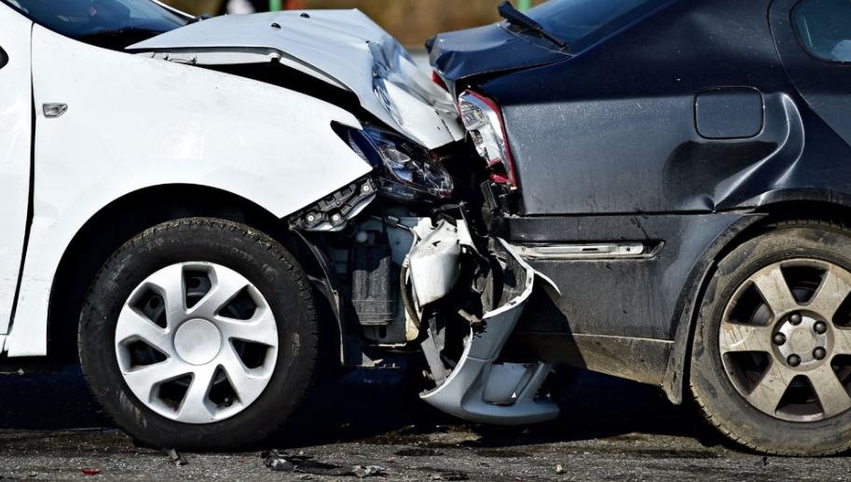
.0532 Brakes
(1) Footbrakes shall not be approved if:
(a) When applying brakes to the moving vehicle, braking force is not distributed evenly to all wheels originally equipped with brakes by the manufacturer.
The Inspection Mechanic must drive
the vehicle to make this test. The
Inspection Mechanic may check the
brakes while driving the vehicle
forward into the inspection area.

Slide 16
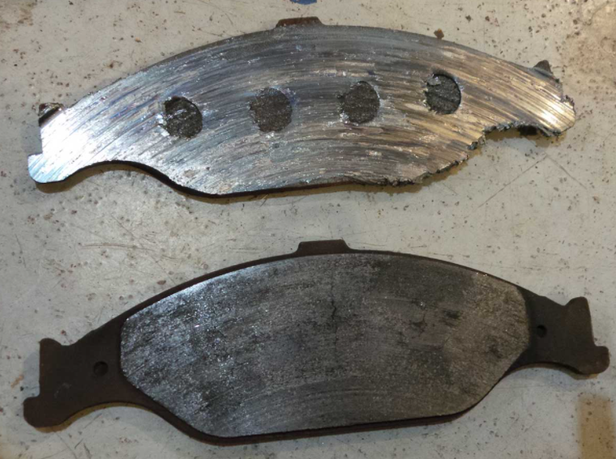
.0532 Brakes
Continued: Footbrakes shall not
be approved if:
(b) There is audible indication (metal to metal) that the brake lining is no longer serviceable.
(The wheel must be removed, and the brake lining examined when this occurs.)

Slide 17
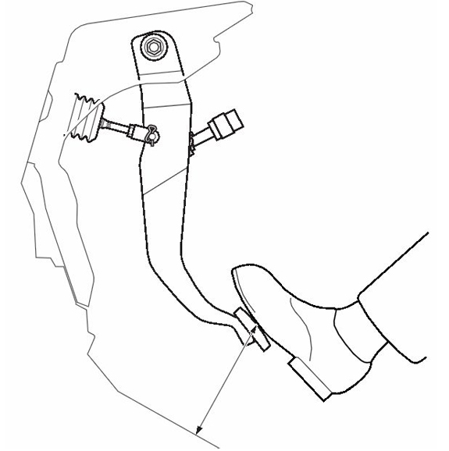
.0532 Brakes
Continued: Footbrakes shall not
be approved if:
(c) Pedal reserve is less
than 1/3 of the total
possible travel when
the brakes are fully
applied, or does not
meet the manufacture’s
specifications for power
brakes or air brakes.

Slide 18
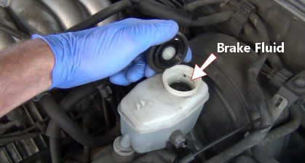
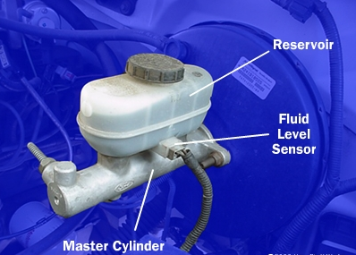
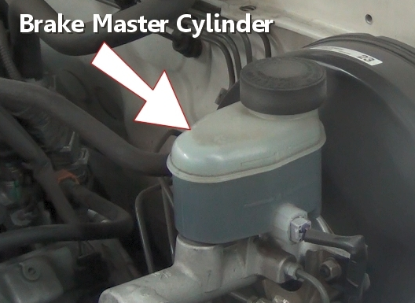
.0532 Brakes
Continued: Footbrakes shall not be approved if:
(d) The reservoir of the
master cylinder is not
full.
Reservoir filled
according to manufacture
specifications.
The inspection
mechanic must
remove the reservoir
cap to verify fluid and
level unless fill line is visible.

Slide 19
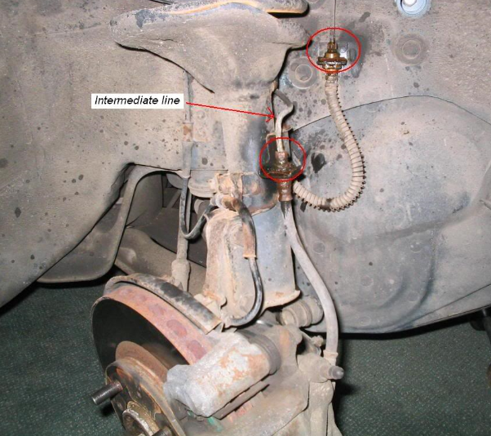
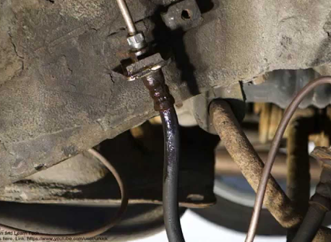
.0532 Brakes
Continued: Footbrakes shall not be approved if:
(e) There is visible leakage or audible seepages in hydraulic,
vacuum or air lines and cylinders, or visible cracked, chafed,
worn or weakened hoses.
Pay close attention to vehicles with oversized tires or rims because they may rub the brake hoses.

Slide 20
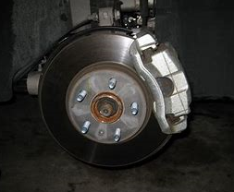
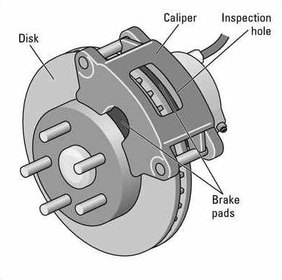
.0532 Brakes
Continued: Footbrakes shall not be
approved if:
(f) The vehicle has any part
of the brake system
disconnected, the brake lines
and hoses do not meet the
manufacturer’s specifications
or are made of a material not
approved for motor vehicles.

Slide 21
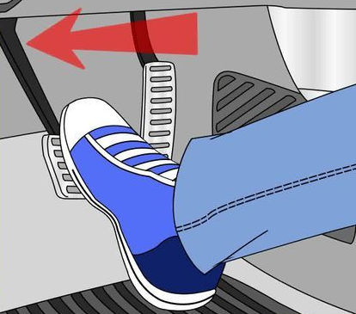
.0532 Brakes
Continued: Footbrakes shall not
be approved if:
(g) Once applied, and while
holding pedal pressure for
one minute, the brake
pedal gradually moves
toward the toeboard,
indicating fluid leakage.

Slide 22
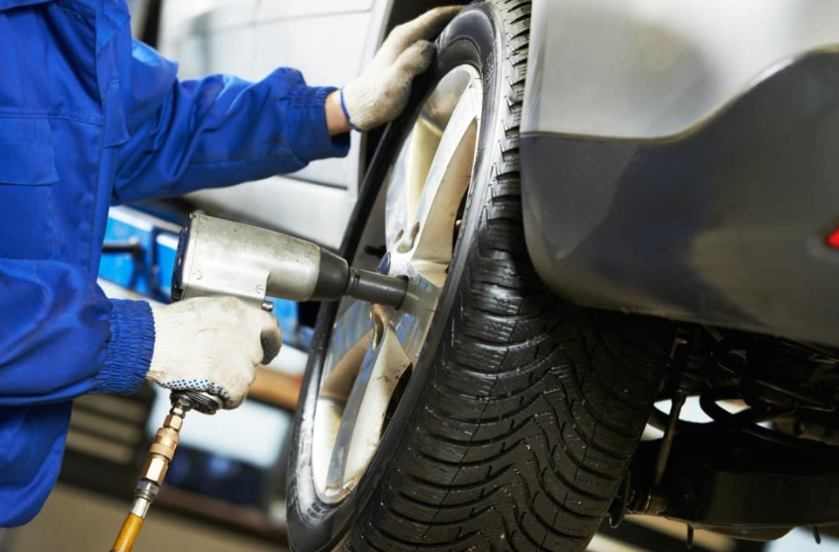
.0532 Brakes
Continued: Footbrakes shall not
be approved if:
(2) Inspection mechanics are not
required to remove wheels of the
vehicle to examine the condition
of the brakes. (Except as provided
previously in this Rule.)
An inspection mechanic shall
raise vehicles to check the
underside of a vehicle, including
the applicable brake components
list in this Rule.

Slide 23
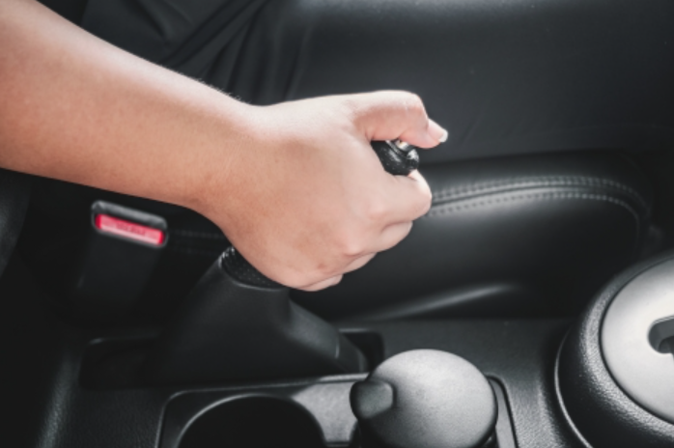
.0532 Brakes
Continued: Footbrakes shall not
be approved if:
(3) Auxiliary, parking, or
holding handbrakes shall
not be approved if:
(a) There is no lever reserve
when the brake is fully
applied.
Some Chevrolet Trucks/SUVs will have no lever reserve from the factory.

Slide 24
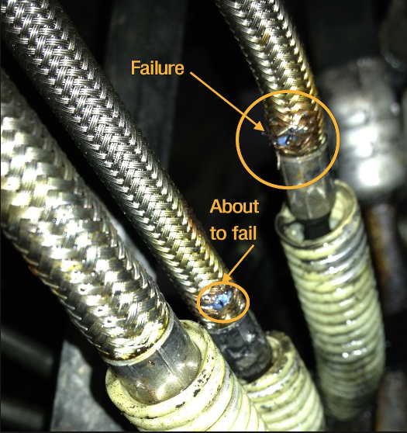
.0532 Brakes
Continued: Footbrakes shall not
be approved if:
(b) Cables are visibly frayed
or frozen, or there are missing
or defective cotter pins, broken
or missing retracting springs, or
worn rods or couplings.

Slide 25
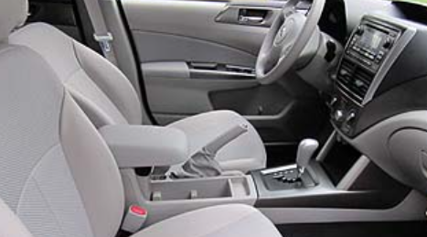
.0532 Brakes
Continued: Footbrakes shall not
be approved if:
(c) The operating mechanism,
when fully applied, fails to
hold the brakes in the applied
position without manual effort
i.e. The lever will not stay set.
Some levers are pump to set.

Slide 26
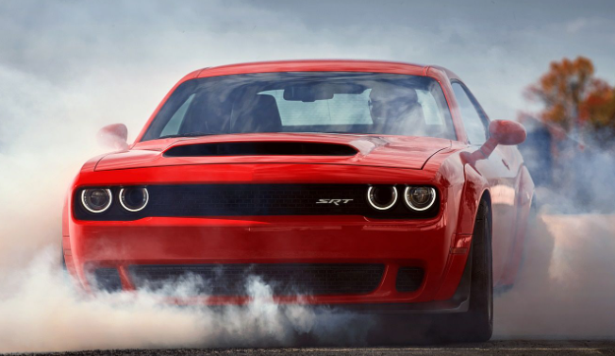
.0532 Brakes
Continued: Footbrakes shall not
be approved if:
(d) When emergency or
handbrakes are applied,
without depressing the
accelerator, they fail to
hold vehicle.
Emergency brake should be tested by setting the brake with the vehicle running and in gear. Do not depress the accelerator while performing this test.

Slide 27
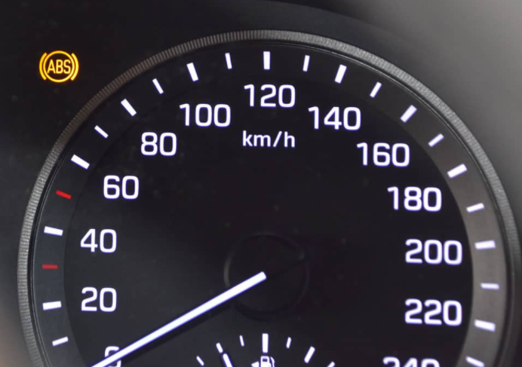
The illumination of the “ABS” light does not constitute a failure Unless the ABS unit is leaking or damaged. If there is an electrical malfunction of the ABS system, the manufacture is required to use the service brake as a “back-up plan”.

Slide 28
G.S. 20-124 states:
(a) Every motor vehicle when operated upon a highway shall be equipped with brakes adequate to control the movement of and to stop such vehicle or vehicles, and such brakes shall be maintained in good working order and shall conform to regulations provided in this section. (b) Repealed by Sess Law)
(c) Every motor vehicle when operated on a highway shall be equipped with brakes adequate to control the movement of and to stop and hold such vehicle and shall have all originally equipped brakes in good working order, including two separate means of applying the brakes. If these two-separate means of applying the brakes are connected in any way, they shall be so constructed that failure of any one part of the operating mechanism shall not leave the motor vehicle without brakes.
Additional Sections (d) through (h) specified in Lesson Plan.

Slide 29
.0533 Lights (Headlights)
G.S. 20-129(a) states:
Every vehicle upon a highway within this State Shall be equipped with lighted headlamps and rear lamps as required for different classes of vehicles.
As a “Rule of Thumb” for lights being inspected. If the lights were installed by the manufacturer, they are approved by the Commissioner.
Fog lamps or auxiliary lamps are not required and are not part of the safety inspection.

Slide 30
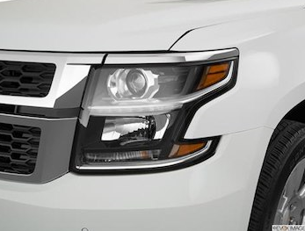
.0533 Lights (Headlights)
(a) Headlights shall conform to the requirements of G.S. 20-129(b)
Headlights shall not be approved if:
(1) There are not at least two headlamps, or at least four on dual headlamp systems. Motorcycles and motor driven cycles need only one headlamp;

Slide 31
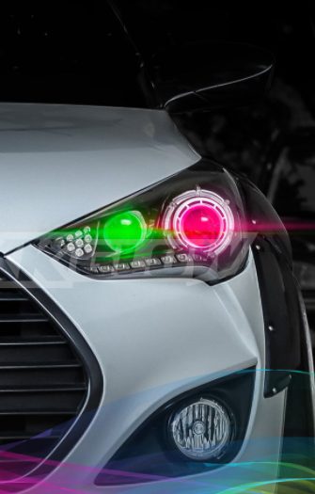
.0533 Lights (Headlights)
Continued: Headlights shall not be approved if:
(2) The headlamp lens or light produces other than a white or yellow light.
Xenon lights installed by the manufacturer and Xenon light replacement kits are allowed.
Colored headlamp bulbs are illegal and constitute as a failure.
If unable to determine the color of the bulb, hold a piece of white paper in front of the light beam.

Slide 32
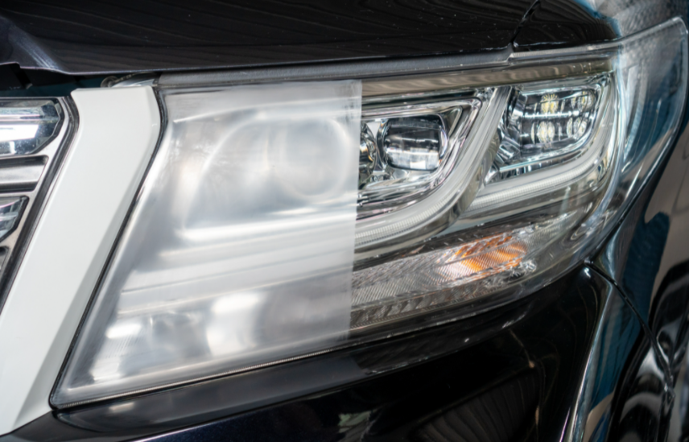
.0533 Lights (Headlights)
Continued: Headlights shall not be approved if:
(3) Any lens or reflector
is cracked, broken,
discolored, or missing.

Slide 33
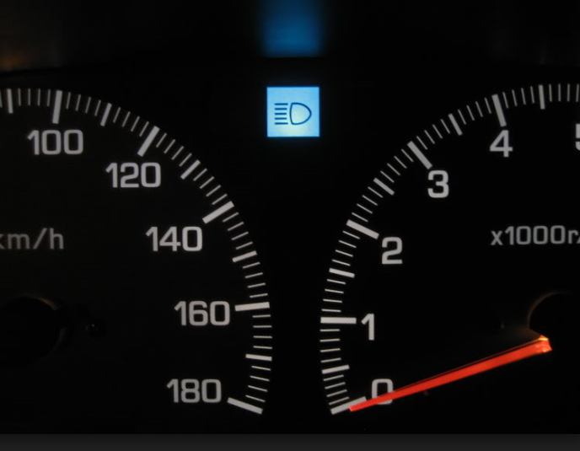
.0533 Lights (Headlights)
Continued: Headlights shall not be approved if:
(4) The high beam-low
beam dimmer switch
does not operate, or
the high beam indicator
light does not burn on
vehicles.
Low speed and MUV vehicles are not required to have a high beam indicator.

Slide 34
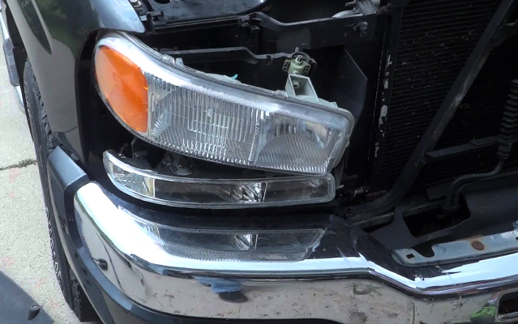
.0533 Lights (Headlights)
Continued: Headlights shall not be approved if:
(5) Lights can be moved
by hand, due to broken
fender or loose support,
or if a good ground is not
made by the mounting.

Slide 35
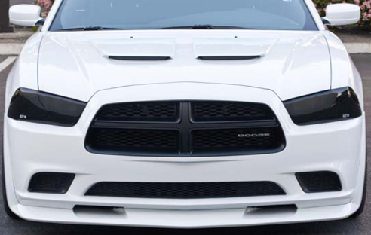
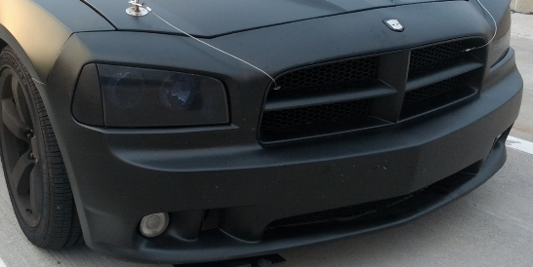
.0533 Lights (Headlights)
Continued: Headlights shall not be approved if:
(6) Foreign materials
such as shields, half of
lens painted are placed
on the headlamp lens
that interferes with the
light beam of lamp.
FAIL

Slide 36
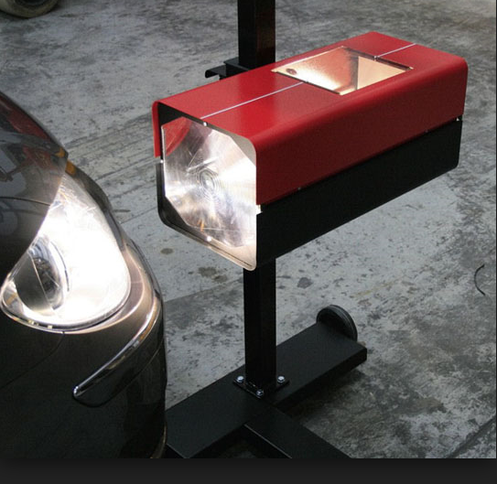
.0533 Lights (Headlights)
Continued: Headlights shall not be approved if:
(7) Lights are improperly aimed.
Using a headlight testing device
that meets Society of Automotive
Engineers’ (SAE) standards or light
testing chart that is approved by the
Division.
The Headlamp alignment must be
checked during each inspection by
use of approved headlight aimer,
undamaged on-board aimer or wall
chart.
Failing to properly test the vehicle headlight alignment could result in a criminal fine, civil fine or both.
“Adjusting” the headlights is considered a correction.

Slide 37

.0533 Lights (Headlights)
Continued: Headlights shall not be
approved if:
(8) Lights project a dazzling or
glaring light when on low beam
as defined in G.S. 20-131(b)
20-131(b) Headlamps comply with the provisions prohibiting glaring and dazzling lights if none of the main bright portion of the headlamp beams rise above 42 inches, 75 feet ahead of the vehicle.
Dazzling or glaring may be caused by a high beam bulb installed in a low beam position.

Slide 38
.0533 Lights (Headlights)
Continued: Headlights shall not be approved if:
(9) the vehicle is equipped with headlamps that change the
original design or performance of the headlamps; or do
not comply with Federal Motor Vehicle Safety Standard
No. 108, as adopted by the National Highway Traffic
Safety Administration.

Slide 39

Headlight Aiming
The following video is intended for informational purposes only. The NCDMV License & Theft Bureau does not endorse any particular brand or manufacturer.

Slide 40
.0533 Lights (Headlights)
Due to the increased intensity and performance of modern headlights it is imperative that the headlights on each vehicle be checked.
Headlamps must be checked during each inspection by use of approved headlight aimer, undamaged on-board aimer or wall chart.
Failing to properly test the vehicle headlight adjustment could result in a criminal fine, civil fine or both.

Slide 41
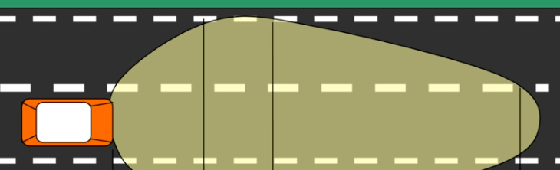
General Statute
20-131(a) The Headlamps of motor vehicles shall be so constructed, arranged, and adjusted that, they at all times, under normal atmospheric conditions, produce a driving light sufficient to render clearly a person 200 feet ahead. Every new motor vehicle, other than a motorcycle or motor‑driven cycle, registered in this State after January 1, 1956, which has multiple‑beam road‑lighting equipment shall be equipped with a beam indicator, which shall be lighted whenever the uppermost distribution of light from the headlamps is in use. Sections (b) through (e) listed in lesson plan.
[-----------------------200 Feet-------------------------]

Slide 42
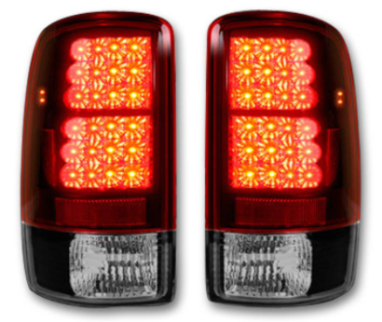
.0533 Lights (Rear Lights)
(b) Rear lights shall
conform to the requirements
of G.S. 20-129(d).
Taillights shall not be approved
if:
(1) All original equipped rear lamps
or the equivalent are not in
working order.
After-market and trailer lights
are acceptable as long as they
are securely attached and
project light to the rear of the
vehicle.

Slide 43
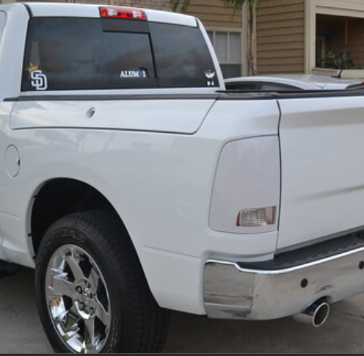
.0533 Lights (Rear Lights)
Continued: Taillights shall not be
approved if:
(2) The lens is cracked or
discolored, the lens or light
projects a color other than red,
or is covered by a foreign
material, such as shields or
painted lenses. Cracks on
lenses shall not lead to
disapproval unless water is
likely to short out the bulb.
The use of repair tape is not acceptable to pass the safety inspection.

Slide 44

.0533 Lights (Rear Lights)
Continued: Taillights shall not be approved if:
(3) They do not operate properly or project white light
on the license plate (Even in a two-bulb system only
one bulb is required to illuminate on the license
plate light)
License Plate Light
License Plate lights must be white in color and illuminate the tag to be read 50 feet away.
Neon license plate lights will not be approved.

Slide 45
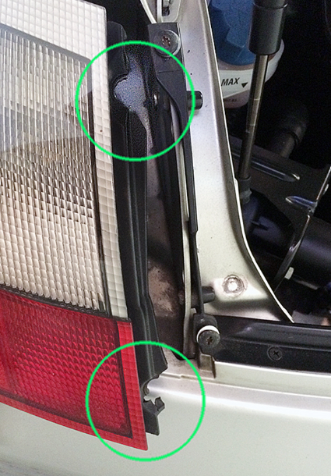
.0533 Lights (Rear Lights)
Continued: Taillights shall not be approved if:
(4) They are not mounted.
No magnetic or “temporary” mounting is acceptable.

Slide 46
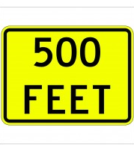
General Statute
(d) 20-129 (d) Rear Lamps. – Every motor vehicle, and every trailer or semitrailer attached to a motor vehicle and every vehicle which is being drawn at the end of a combination of vehicles, shall have all originally equipped rear lamps or the equivalent in good working order, which lamps shall exhibit a red light plainly visible under normal atmospheric conditions from a distance of 500 feet to the rear of such vehicle.
Rear Lamps -
One rear lamp or a separate lamp shall be so constructed and placed that the number plate carried on the rear of such vehicle shall under like conditions be illuminated by a white light as to be read from a distance of 50 feet to the rear of such vehicle.

Slide 47
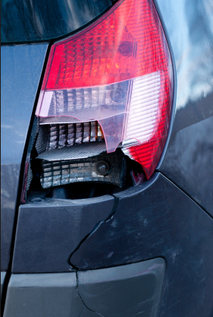
.0533 Lights (Stoplights)
(c) Stoplights shall conform to the requirements of G.S. 20-129(g).
Stoplights shall not be approved if:
(1) The lens is cracked, discolored, or the lens or light projects a color other than red or amber, or is covered by a foreign material such as shields or painted lenses. Cracks on lenses shall not lead to disapproval unless water is likely to short out the bulb.
Minor cracks on lenses shall not lead to disapproval unless water is likely to enter lens and lead to bulb failure.

Slide 48
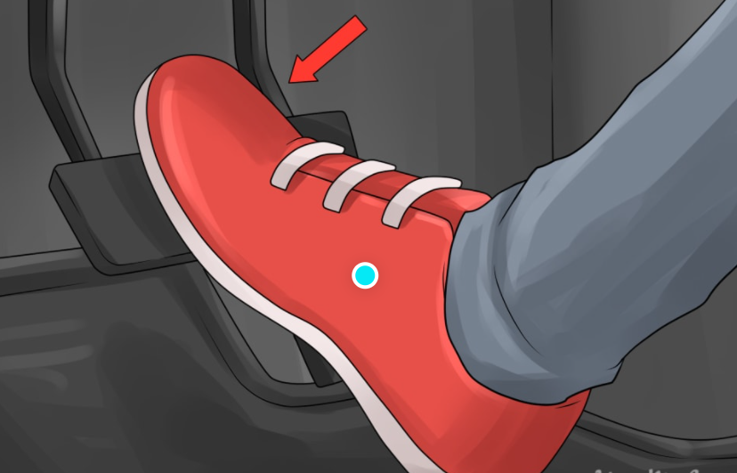
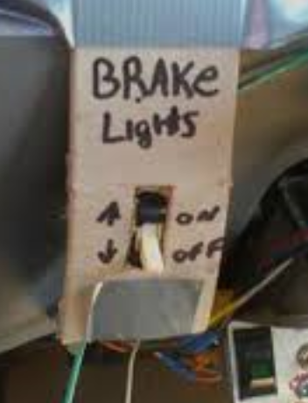
.0533 Lights (Stoplights)
Continued: Stoplights shall not be approved if:
(2) It does not come on when pressure is applied to the
footbrake.
Proper Procedure to check stoplight operation:
  Use a pedal lock rod; or
  Use an approved mirror or reflecting windows of bay doors; or
  Have someone else depress the brake pedal while the inspector/mechanic looks at the bulbs.
The licensed Inspector Mechanic performing the safety inspection must observe the illumination of the bulb.

Slide 49
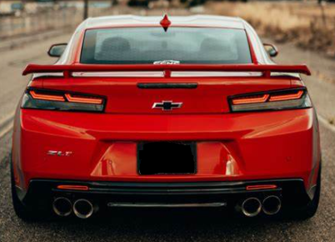
.0533 Lights (Stoplights)
Continued: Stoplights shall not be approved if:
(3) They are not mounted so as to project light to the rear.

Slide 50
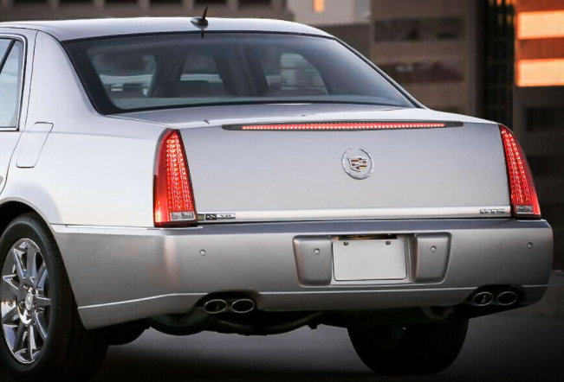
General Statute
G.S 20-129(g), No person shall sell or operate on the highways of the State any motor vehicle manufactured after December 31, 1955, and on or before December 31, 1970, unless it shall be equipped with a stop lamp on the rear of the vehicle. No person shall sell or operate on the highways of the State any motor vehicle, manufactured after December 31, 1970, unless it shall be equipped with stop lamps, ONE ON EACH SIDE of the rear of the vehicle.
The third brake is not required
to illuminate to pass a safety
inspection.

Slide 51

G.S 20-129(g) continued
No person shall sell or operate on the highways of the State any motorcycle or motor-driven cycle manufactured after December 31, 1955, unless it shall be equipped with a stop lamp on the rear of the motorcycle or motor-driven cycle .
The stop lamps shall emit, reflect, or display a red or amber light visible from a distance of not less than 100 feet to the rear in normal sunlight, and shall be actuated upon application of the service (foot) brake. The stop lamps may be incorporated into a unit with one or more other rear lamps.
- 100 FEET

Slide 52
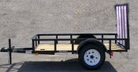
Additional Lighting
Some vehicles require additional lighting which is addressed under G.S. 20-129.1. Examples of these vehicles are:
Buses
Trucks
Truck Tractor
Trailer or Semitrailer (gross weight 4,000lbs & greater) Trailers with a gross weight of less than 4,000 pounds are exempt from the inspection requirement.
Pole Trailer
Additional lighting specifications are listed in the lesson plan

Slide 53
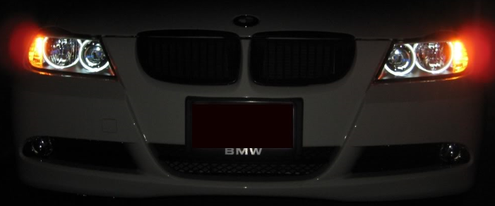
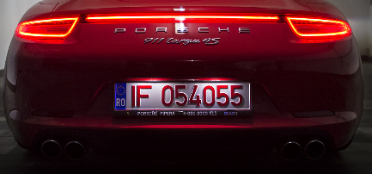
.0533 Lights (Parking lights)
(e) Parking lights shall conform to the requirements of G.S. 20-134.
A vehicle shall not be approved if parking lights are not working or covered by a foreign material, such as shields or painted lenses.

Slide 54
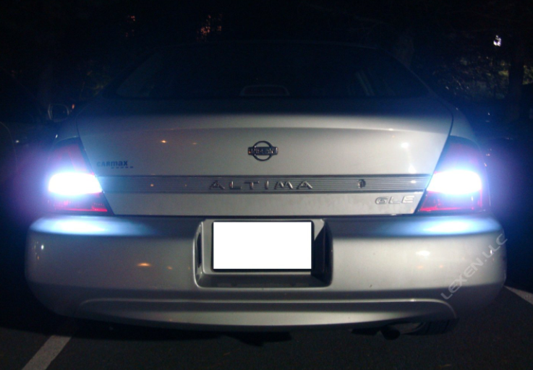
.0533 Lights (Back-Up Lights)
(f) Back-Up Lights. A motor vehicle that was originally
equipped with back-up lamps, lamps, must have those
lamps maintained in operating condition. Backup lamps
shall not be lighted when the motor vehicle is in a forward
motion, nor shall the backup lamp emit any color other
than white.
(No more than 2 allowed)
A back-up lamp is not a
mandatory requirement
for the Inspection.

Slide 55
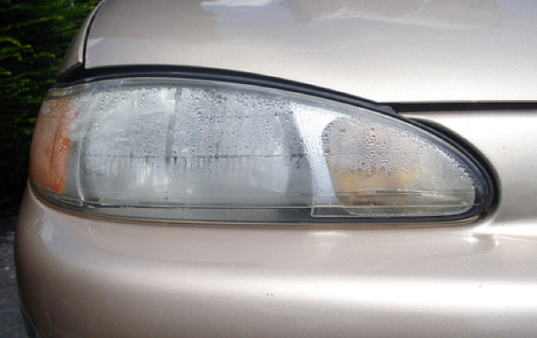
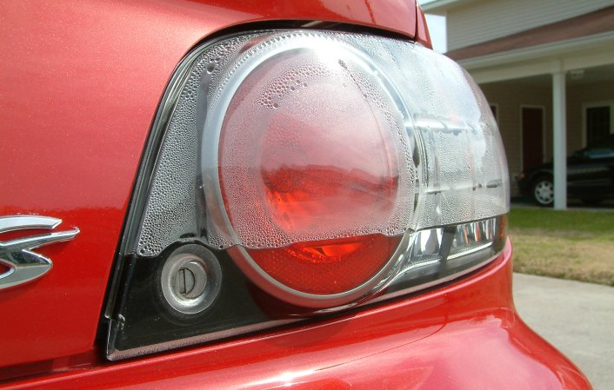
.0533 Lights
Condensation inside any lenses alone does NOT constitute a failure. Disapprove if there is standing water inside the lens.
Reflectors are not required equipment on passenger vehicles.

Slide 56
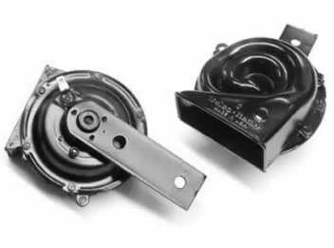

.0534 Horn
(a) In addition to the requirements set forth in G.S. 20-125,
The horn shall not be approved if:
(1) it will not emit a sound audible for
a distance of at least 200 feet.
Original equipment, operating as
intended by the manufacturer, shall
meet these requirements. Air horns
shall not be substituted for
original equipment.

Slide 57
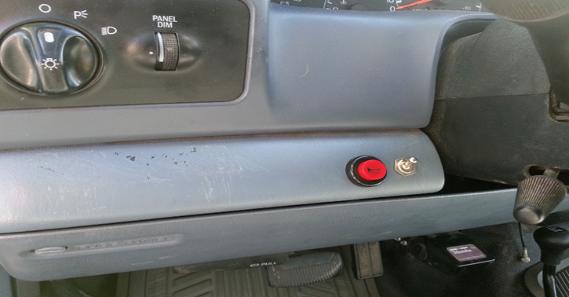
.0534 Horn
Continued: The horn shall not be approved if:
(2) the wiring or wiring harness
has been frayed, been damaged,
is broken, or is missing wiring;
the horn button is not mounted
to the motor vehicle or is not
positioned within the driver’s
reach.
(3) Operation of the horn interferes
with the operation of any other
mechanism.

Slide 58
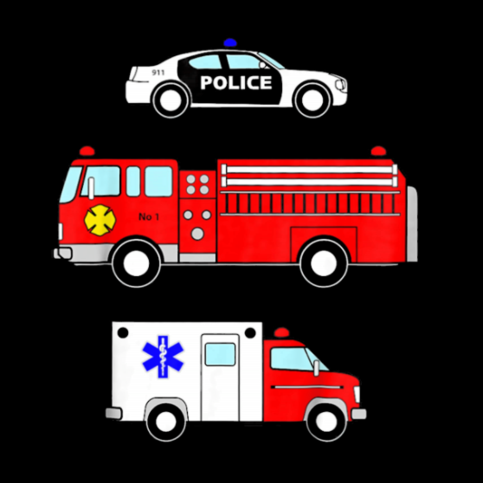
.0534 Horn
Continued: The horn shall not be approved if:
(b) Vehicles equipped with sirens shall not be approved
unless they are within the class listed in G.S. 20-125(b)
as being authorized to carry a siren.
In addition to the use of special equipment authorized and required by this subsection, the chief and assistant chiefs of any police department or of any fire department, whether the same be municipal or rural, paid or voluntary, county fire marshals, assistant fire marshals, transplant coordinators, and emergency management coordinators, are hereby authorized to use such special equipment on privately owned vehicles operated by them while actually engaged in the performance of their official or semiofficial duties or services either within or beyond their respective corporate limits.

Slide 59

General Statute
G.S. 20-125 states:
Every motor vehicle when operated on a highway or public vehicular area shall be equipped with a horn in good working order capable of emitting sound audible under normal condition from a distance of not less than
200 feet.

Slide 60
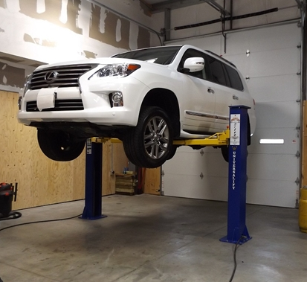
.0535 Steering Mechanism
(a) The inspection
mechanic must raise
the vehicle check the
steering mechanism.
Pits are OK but, you MUST raise the tires off the floor.

Slide 61
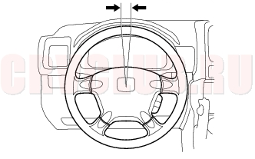
.0535 Steering Mechanism
(b) The steering mechanism
shall not be approved if:
(1) With front wheels in straight ahead position there is more than 3 inches of free play in steering wheels up to 18 inches in diameter or more than 4 inches of free play in steering wheels over 18 inches in diameter. If the vehicle is equipped with power steering, the engine must be operating.
1 ½ “ Side to Side = 3” of free play.

Slide 62


.0535 Steering Mechanism
Continued: The steering mechanism shall not be approved if:
(2) Either front or rear springs are
noticeably sagging or broken.

Slide 63

.0535 Steering Mechanism
Continued: The steering
mechanism shall not be
approved if:
(3) The front wheels or
front-end assembly is
loose, bent, or twisted; or
bolts, nuts, or rivets are
loose or missing
To fail a vehicle for missing lug nuts or missing studs is the discretion of the inspection mechanic.

Slide 64

.0535 Steering Mechanism
Continued: The steering
mechanism shall not be
approved if:
(4) Power steering system shows visible leaks, or the power steering belt is loose, worn.
Rack-N-Pinion steering mechanisms with “morning sickness” fails ONLY if tightness or slippage occurs during the inspection.

Slide 65

.0535 Steering Mechanism
Continued: The steering mechanism shall not be approved if:
(5) vehicle frame or component of the
steering mechanism is rusted to the
point of mechanical failure

Slide 66

.0535 Steering Mechanism
Continued: The steering mechanism shall not be approved if:
(6) shock or strut is leaking to the point of failure
that will inhibit the steering of
the vehicle.

Slide 67
General Statute
G.S. 20-123.1 states:
The steering mechanism of every self-propelled motor vehicle operated on a highway or public vehicular area shall be maintained in good working order, sufficient to enable the operator to control the vehicle’s movements and maneuver it safely.

Slide 68

.0536 Windshield Wiper
Windshield wipers shall
not be approved if:
(1) The vehicle is not equipped
with a windshield wiper or
wipers, provided the vehicle
has a windshield.

Slide 69

.0536 Windshield Wiper
Continued: Windshield wipers shall not be approved if:
(2) The wiper or wipers do
not operate freely.
(3) The wiper controls are
not so constructed and
located that the driver
may operate them.

Slide 70

.0536 Windshield Wiper
Continued: Windshield wipers shall not be approved if:
(4) The wiper or wipers are not adequate to clean rain, snow and other matter from the windshield.
(5) Parts of the blades or arms are missing or show evidence of damage.
Damage to the windshield is not considered a failure UNLESS it affects the wipers as specified above.
A rear wiper is not required to pass a safety inspection
The Windshield is not part of the Safety Inspection.

Slide 71

General Statute
G.S. 20-127 states:
A vehicle that is operated on a highway and has a windshield shall have a windshield wiper to clear rain or other substances from the windshield in front of the driver of the vehicle and the windshield wiper shall be in good working order. If a vehicle is equipped with more than one windshield wiper to clear substances from the windshield, all windshield wipers shall be in good working order.

Slide 72

.0537 Direction Signals
Vehicles required to have
directional signals pursuant to
G.S. 20-125.1, which does not
include motorcycles,
shall be disapproved if:

Slide 73


.0537 Direction Signals
Continued: Direction Signals shall not be approved if:
(1) The vehicle is not equipped with signals by which the operator of the vehicle may indicate to other motorists approaching from a distance of 200 feet from the front or rear the operator's intentions to turn the vehicle;

Slide 74

.0537 Direction Signals
Continued: Direction Signals shall not be approved if:
(2) All lights do not operate properly, or any lenses are broken, missing, or do not fit properly.
(3) Signal lens or light color is other than red or amber on the rear and other than white or amber on the front, and is covered by a foreign material, such as shields and painted lenses.

Slide 75

.0537 Direction Signals
Continued: Direction Signals shall not be approved if:
(4) Lamps are not mounted or wiring, and connections are not working;
(5) Signals are not visible from front or rear due to faulty or damaged mounting or due to manner in which they are mounted.
Damage
Minor cracks on lenses shall not lead to disapproval unless water is likely to enter lens and lead to bulb failure.

Slide 76

.0537 Direction Signals
Continued: Direction Signals shall not be approved if:
(6) switch does not operate as designed by the manufacturer or is not located in a position that allows the operator to reach and operate the switch, or the switch that interferes with the operation of other mechanisms.

Slide 77
.0537 Direction Signals
Trailers satisfying the following conditions are not required to be equipped with a directional signal device:
(1) The trailer and load does not obscure the directional
signals of the towing vehicle from the view of a driver
approaching from the rear and within a distance of
200 feet;
(2) The gross weight of the trailer and load does not
exceed 4,000 pounds.

Slide 78

General Statute
G.S. 20-125.1 states:
Vehicles that are operated on a highway or public vehicular area must have a mechanical or electrical signal device by which the operator of another vehicle can see the intention to turn the vehicle.

Slide 79

.0538 Tires
(1) Any tire has cuts or snags that expose the cords.
Foreign objects in tires and dry rotting that constitute failure is the discretion of the inspection mechanic.
(a) A vehicle shall be disapproved if:

Slide 80

.0538 Tires
Continued: Any vehicle shall be disapproved if:
(2) Any tire has a visible bump, bulge, or knot related to tread or sidewall separation or partial failure of the tire structure including bead area;
Secondary rubber and sidewall damage, due to low tire pressure, shall constitute a failure if it is an immediate safety hazard.

Slide 81

.0538 Tires
Continued: Any vehicle shall be disapproved if:
(3) there is less than 2/32-inch tread at two or more
locations around the circumference of the tire in
two adjacent major tread grooves or if the tread wear
indicators are in contact with the roadway at
two or more locations around the circumference of the
tire in two adjacent major tread grooves.
Tire depth shall be measured by a tread depth gauge which shall be of a type calibrated in
thirty seconds of an inch. Readings for a tire with a tread design that does not have two
adjacent grooves near the center shall be taken at the center of the tire around the
circumference of the tire. Each tire must be completely lifted from the ground for an
inspection to be performed.

Slide 82

.0539 Tires
(b) Tire depth shall be measured
by a tread depth gauge which
shall be of a type calibrated in
thirty-seconds of an inch.
Readings for a tire with a tread
design that does not have two
adjacent grooves near the center
shall be taken at the center of the
tire around the circumference of
the tire. Each tire must be
completely lifted from the ground
for an inspection to be performed.
Secondary rubber and sidewall damage, due to low tire pressure, shall constitute a failure if it is an immediate safety hazard.

Slide 83
.0539 Tires
G.S. 20-122.1. Motor vehicles to be equipped with safe tires.
(a) Every motor vehicle subject to safety equipment inspection in this State and operated on the streets and highways of this State shall be equipped with tires which are safe for the operation of the motor vehicle, and which do not expose the public to needless hazard. Tires shall be considered unsafe if cut so as to expose tire cord, cracked so as to expose tire cord, or worn so as to expose tire cord or there is a visible tread separation or chunking or the tire has less than two thirty-seconds inch tread depth at two or more locations around the circumference of the tire in two adjacent major tread grooves, or if the tread wear indicators are in contact with the roadway at two or more locations around the circumference of the tire in two adjacent major tread grooves: Provided, the two thirty-seconds tread depth requirements of this section shall not apply to dual wheel trailers.

Slide 84

.0539 Tire Definitions
As used in this and Rule .0538 of this Section,
these terms have the following meanings:
(1) "Bead" is that part of the tire that is shaped to fit the rim.
The bead is made of high tensile steel wires wrapped and
reinforced by the plies.
(2) "Cord" is made from textile, steel wire strands forming the plies or other structure of the tires.
(3) "Groove" is the space between two tread ribs.
(4) "Ply" is layers of rubber coated parallel cords forming the
tire body.
(5) "Rib" is the tread section running circumferentially around the tire.
(6) "Rim" is a metal support for the tire or tire and tube
assembly on the wheel. Tire beads are seated on the rim.
(7) "Sidewall" is that portion of the tire between tread and bead.

Slide 85

.0540 Rear View Mirrors
Rear View Mirrors shall not be approved if:
(1) There is any movement between the
attachment bracket and the windshield;
(2) Forward vision of the device is obstructed by
mirror assembly;
(3) They do not provide a view of the highway to
the rear;
(4) They are cracked, broken, have sharp edges or
cannot be cleaned such that rear vision is not
obscured;
(5) They cannot be adjusted or will not maintain a
set adjustment;

Slide 86

.0540 Rear View Mirrors
Continued: Mirrors shall not be approved if:
(6) Bus, truck, or truck-tractor with a GVWR of 10,001 pounds or more is not equipped with a rear vision mirror on each side. If a vehicle is configured in such a way that the inside mirror is obstructed, a passenger side outside mirror is required;
(7) Vehicles manufactured, assembled, or first sold after January 1, 1966 are not equipped with outside rear view mirrors on the driver's side. The passenger's outside rear view mirror is not required equipment on passenger vehicles if an inside rear view mirror is present.

Slide 87
.0540 Rear View Mirrors
If a vehicle is loaded or configured in such a way that the inside mirror is obstructed, a passenger side outside mirror would be required.
The passenger’s outside rearview mirror is NOT required equipment on passenger vehicles if an inside rearview mirror is present.

Slide 88
General Statute
G.S. 20-126 (a) states:
No person shall drive a motor vehicle on the streets or highways of this state unless equipped with an inside rearview mirror of a type approved by the commissioner, which provides the driver with a clear, undistorted and reasonably unobstructed view of the highway to the rear vehicle; provided, a vehicle soon constructed or loaded as to make an inside mirror ineffective.

Slide 89

.0541 EXHAUST EMISSION CONTROLS
a) An exhaust emission shall not be approved if the vehicle is a
1968-year model or newer and any of the visible emission
control devices placed thereon by the manufacturer are
missing, disconnected, made inoperative, or as set forth in
G.S. 20-128(d) have been altered without approval of the
Department of Environmental Quality

Slide 90

.0541 EXHAUST EMISSION CONTROLS
b) If the unleaded gas restrictor on a vehicle manufactured
after model year 1967 has been altered or removed a new
or reconditioned catalytic converter and unleaded gas
restrictor must be replaced before the vehicle shall pass
inspection.
When an unleaded fuel restrictor is tampered with, it is alleged that leaded fuel has been used. Once leaded fuel is burned through the engine and exhausted, the lead particles destroy the catalyst components of the catalytic converter.

Slide 91

.0541 EXHAUST EMISSION CONTROLS
(c) An exhaust system shall not be approved if:
(1) The vehicle has no muffler or other exhaust system of the type installed at
the time of manufacture or does not operate as designed by the vehicle
manufacturer;
(2) The muffler, exhaust, or tail pipes have leaking joints;
(3) The exhaust or tail pipes have holes, leaking seams, or leaking patches on muffler;
(4) the tail pipe end is pinched;
(5) the exhaust system is equipped with muffler cut-out or muffler by-pass
(6) any part of the system passes through the passenger compartment.
Many mufflers are manufactured with
one or more seep holes. The presence
of a seep hole does not constitute failure.

Slide 92


.0542 Emission Control Devices
A civil penalty shall be assessed against individuals who instruct or allow a person to remove, disconnect, tamper with, or render inoperable any emission control device equipped by the manufacturer of any motor vehicle as described in G.S. 20-183.3.

Slide 93

.0542 Emission Control Device
These devices include:
(1) Catalytic Converter
Vehicle originally equipped with
a catalytic converter will fail for
the tampering portion of the
inspection if a new exhaust
system is installed without a
catalytic converter.
.

Slide 94
.0542 Emission Control Devices
(2) Unleaded Gas Restrictor
(3) Air Pump System,
There are 2 types of Air Pumps Systems;
1) The pump type is either electrical or belt
driven. A missing air or smog pump belt is a
failure of the Air Pump System.
2) P.A.I.R. does not require a pump and uses the
normal pulsing from the exhaust valves
opening and closing.
The removal of engine covers, or shields is not required.

Slide 95



.0542 Emission Control Devices
(4) EGR (Exhaust Gas Recirculation) Valve
EGR Valves are either vacuum operated or electrically operated.

Slide 96


.0542 Emission Control Devices
(5) PCV (Positive Crankcase
Ventilation) Valve
A missing oil filler cap or oil dipstick DOES NOT constitute a failure.
Not all vehicles are equipped with a actual PCV Valve. Some may be equipped with PCV system that utilizes an orifice in lieu of a valve.

Slide 97

.0542 Emission Control Devices
(6) Thermostatic Air Cleaner
Verify that all vacuum hoses, the preheat tube, PCV System hoses are connected and that the lid is securely attached.
Only 2 things can be missing snorkel hose and the air filter.

Slide 98


.0542 Emission Control Devices
Charcoal Canister
Purge Valve
(7) Evaporative Emission Systems
The Evaporative Emission System consists of the charcoal canister, the purge system, the fuel tank and cap, vacuum lines and fuel return and supply lines.
Disconnected charcoal canister purge vacuum lines fail the Evaporative Emission System.

Slide 99



.0542 Emission Control Devices
(8) Oxygen Sensor.
Meters the amount of oxygen in the exhaust gases.
Most manufactures install more than one oxygen sensor;
the inspection mechanic is required to visually inspect all.

Slide 100
.0542 Emission Control Devices
Vehicles are required to have emission control devices as installed by the manufacturer to be present, connected and in a visually operative condition.
The Emission Control System Applications Manual, Mitchell on Demand and All Data are examples of sources to determine what the manufacturer installed on most vehicles.

Slide 101
General Statute
G.S. 20-128. Exhaust system and emissions control devices - (a) No person shall drive a motor vehicle on a highway unless such motor vehicle is equipped with a muffler, or other exhaust system of the type installed at the time of manufacture, in good working order and in constant operation to prevent excessive or unusual noise, annoying smoke and smoke screens.
(b) It shall be unlawful to use a "muffler cut-out" on any motor vehicle upon a highway.
(c) No motor vehicle registered in this State that was manufactured after model year 1967 shall be operated in this State unless it is equipped with emissions control devices that were installed on the vehicle at the time the vehicle was manufactured and these devices are properly connected.
(d) The requirements of subsection (c) of this section shall not apply if the emissions control devices have been removed for the purpose of converting the motor vehicle to operate on natural or liquefied petroleum gas or other modifications have been made in order to reduce air pollution and these modifications are approved by the Department of Environment and Natural Resources.

Slide 102






Inspection Procedure for Motorcycles
The Inspector must drive the motorcycle into the inspection bay and the motorcycle must be lifted.
A motorcycle endorsement is not required to complete a safety inspection of a motorcycle.

Slide 103

.0544 Safety Inspection of Motorcycles
(a) Motorcycle Brakes shall fail inspection if:
(1) When applying brakes to the moving vehicle,
there is insufficient force to stop the vehicle.
(2) Brakes are worn in such a manner that there is an
uneven braking force.
(3) There is an audible or visual indication that the
brake lining is worn to the extent it is no longer
serviceable.
(4) There is less than one-third reserve in either
footbrake or handbrake total possible travel when
the brakes are fully applied.

Slide 104
.0544 Safety Inspection of Motorcycles
Continued: Motorcycle Brakes shall fail inspection if:
(5) Reservoirs of braking cylinders are not full.
[The Inspection Mechanic is required to remove the master cylinder cap to verify brake fluid level if the level is not visible from the containers outside.
(6) There is a visible leakage of fluid from any brake line
or brake component.
(7) Handbrake cables are frayed, broken, or frozen or
linkage is defective.
Motorcycles are required to be equipped with one brake. (Hand or foot brake).

Slide 105

.0544 Safety Inspection of Motorcycles
General Statute 20-124 - Brakes
Every motorcycle and every motor‑driven cycle when operated upon a highway shall be equipped with at least one brake which may be operated by hand or foot.

Slide 106
.0544 Safety Inspection of Motorcycles
(b) Motorcycle headlamps shall fail safety inspection if:
(1) Headlamp does not operate or is a color other than white.
(2) There is more than two headlamps connected on a single
switch.
(3) Headlamps is cracked or has holes which allows entry of
water.
(4) There is standing water in the headlamp.
(5) Headlamp is out of aim.
Motorcycle headlamp modulators are allowed by Federal Code 49 CFR 571.108

Slide 107


.0544 Safety Inspection of Motorcycles
Harleys, Hondas, and some Kawasaki’s have what appears to be 3 or 4 headlamps. The 2 outer lamps are not headlamps; they are driving lamps and do not constitute a failure.
Motorcycles are not required to have high beam headlamps or high beam indicators.

Slide 108

.0544 Safety Inspection of Motorcycles
General Statute 20-129(c) Headlamps on Motorcycles.
Every motorcycle shall be equipped with at least one and not more than two headlamps which shall comply with the requirements and limitations set forth in G.S. 20‑131 or 20‑132. The headlamps on a motorcycle shall be lighted at all times while the motorcycle is in operation on highways or public vehicular areas.

Slide 109
.0544 Safety Inspection of Motorcycles
(c) Motorcycle rear lamps shall fail safety inspection if:
(1) They do not operate.
(2) Light is a color other than red.
(3) Light is cracked or broken and allows entry of water.
(4) There is standing water in the lens.
(5) Lamp is not securely mounted.
(6) Wiring is broken or frayed.

Slide 110

.0544 Safety Inspection of Motorcycles
The use of rear light integrators is allowed (signal on while brake is applied, one side flashes).
Imported Yamaha’s may be equipped with clear lenses and colored bulbs, as a “Rule of Thumb” if the light was installed by the manufacturer it meets the Commissioner’s requirements.
.0537 Directional Signals
(a) All vehicles, except motorcycles,
must be equipped with turn signals.

Slide 111
.0544 Safety Inspection of Motorcycles
(d) A motorcycle stop lamp shall fail safety inspection if :
(1) Lamp does not operate when brakes are applied.
(2) Light is a color other than red or amber.
(3) Lens is cracked or broken or allows entry of water.
(4) There is standing water in the lens.
(5) Lamp is not mounted.
(6) Wiring is broken or frayed.

Slide 112

.0544 Safety Inspection of Motorcycles
(e) A motorcycle license plate light shall fail safety inspection if:
(1) Light does not operate.
(2) Light does not illuminate the license plate.
(3) Light is a color other than white.
License Plates that have been
relocated still must illuminate
the license plate.

Slide 113

.0544 Safety Inspection of Motorcycles
(f) A motorcycle horn shall fail safety inspection if:
(1) The horn does not operate.
(2) The sound emitted is not audible at 200 feet.
(3) The horn is not mounted.
(4) The button is mounted so that it cannot be easily operated by the
driver.

Slide 114



.0544 Safety Inspection of Motorcycles
(g) Motorcycle tires shall fail safety inspection if:
(1) There is less than 2/32 inch of tread at two or more
locations around the circumference of the tire in two adjacent
major tread grooves, or if the tread wear indicators are in
contact with the roadway at two or more locations around the
circumference of the tire.
(2) Cords are exposed at any location on the tire.
(3) Sidewall is cut, bulging, damaged or is cracked due to dry rotting

Slide 115

.0544 Safety Inspection of Motorcycles
(h) Motorcycle rear view mirror shall fail safety inspection if:
(1) The mirror is missing, broken or cracked.
(2) The mirror is not mounted.
(3) The mirror will not hold a setting while the vehicle is in
operation.
Only one mirror is required.
(There is no requirement on which
side it is located.)

Slide 116

.0544 Safety Inspection of Motorcycles
(i) A motorcycle exhaust shall fail safety inspection if:
(1) The motorcycle has no muffler.
(2) The muffler, exhaust, or tailpipe have holes, leaking joints,
seams or patches.
(3) The tailpipe end is pinched.
Straight Pipes (no muffler)

Slide 117


.0544 Safety Inspection of Motorcycles
A motorcycle exhaust fails if:
(4) The exhaust system is equipped with a muffler cut-out or
bypass.

Slide 118



.0544 Safety Inspection of Motorcycles
A motorcycle exhaust fails if:
(5) The muffler baffles have been removed or damaged to create a straight pipe.

Slide 119

.0544 Safety Inspection of Motorcycles
(j) A motorcycle steering mechanism shall fail safety inspection if:
(1) Front shocks are sagging or broken.
(2) Front end assembly is loose, bent, or there are damaged or
twisted bolts
(3) Front end nuts, bolts, or rivets are loose or missing.
The Inspection Inspector-Mechanic
performing the safety inspection of
a motorcycle is not required to have
motorcycle endorsement.

Slide 120
.0549 Approval and Disapproval of Vehicles
Vehicles shall not be disapproved for any reason other than those specified in General Statute or NCAC.

Slide 121
Exemptions From Safety Test Requirements
An Exemption may be obtained when a vehicle fails a safety inspection because of missing emission control devices by contacting a local DMV Inspector.
Vehicle fails the tamper portion of a vehicle inspection because it does not have one or more emission control devices as required by the vehicle manufacturer.
The consumer will have to show proof that the part needed to pass inspection is no longer manufactured. At least (3) three sources stating that the components are no longer manufactured or available, one of which must be from a dealership, must be provided. The License and Theft Bureau will confirm the availability of the part.

Slide 122
Window tint

Slide 123
.0551 Window Tinting
(a) All stations performing window tinting inspections
shall have a photometer which has been properly
tested and approved by the Commissioner of Motor
Vehicles and that complies with Rule .0552 of this
section. Stations that do not have an approved tint
meter shall not inspect vehicles with after-factory
window tinting. Stations are not required to purchase
a photometer in order to perform safety inspections on
vehicles without after-factory window tinting.
Approved window tint meters and headlight aimers can be found at
https://connect.ncdot.gov/business/DMV/pages/inspection-stations.aspx

Slide 124

.0551 Window Tinting
(b) Prior to initiating the inspection process, the inspection mechanic shall determine if the vehicle has after-factory window tinting by using an automotive film check card or knowledge of window tinting techniques.
Prior to initiating the inspection process on each vehicle.

Slide 125


.0551 Window Tinting
(b) Continued - If the vehicle has after-factory window tinting but the station does not have a light meter approved by the Division, the mechanic must inform the customer he or she is unable to perform the inspection. The station may not charge for any portion of the inspection.

Slide 126
.0551 Window Tinting
(c) The inspector mechanic shall test the photometer calibration against a reference sample of glass provided by the manufacturer prior to testing the after-factory window tinting. If the photometer's display is not functioning as designed by the manufacturer or the device exceeds the net light transmission calibration test by plus or minus three percentage points, the unit shall not be used until repaired. Guidelines for photometer calibration tests are as follows:
(1) The reference sample must be clean and free of dirt prior to
performing the calibration check.
(2) If the reference sample has been broken or is missing, the
test shall not be performed, and the mechanic shall inform
the customer he is unable to perform the inspection.

Slide 127

.0551 Window Tinting
(d) The inspection mechanic shall perform all tests according to the photometer manufacturer's recommendations.
Window tint shall fail safety
inspection if:

Slide 128


.0551 Window Tinting
Window tint shall fail safety inspection if:
(1) Any window on the vehicle with after-factory tint has a light transmission of less than thirty-two percent (32%).
(2) The tint on any window is red, yellow, or amber

Slide 129


.0551 Window Tinting
Window tint shall fail safety
inspection if:
(3) The tint on the windshield extends more than five (5) inches below the top of the windshield or is below the AS1 line of the windshield, which ever measurement is longer.
(4) The light reflectance of a tinted window is not twenty percent (20%) or less.
AS1 Line Right or Left Side of Windshield

Slide 130
.0551 Window Tinting
Window tint shall fail safety inspection if:
(e) Window tinting on vehicles with after-factory window tint shall not be inspected if the vehicle is exempt from the window tinting restrictions under G.S. 20-127(c)
(f) The fee as specified in G.S. 20-183.7(a) for inspecting window tinting shall be charged for vehicles with after factory tint
NOTE: The $10.00 window tint fee charge during an inspection is
mandatory.
G.S. 20-127(c) Tinting Exceptions. The window tinting restrictions in subsection (b) of this section (percentage, color and reflectance) apply without exception to the windshield of a vehicle. The window tinting restrictions in subdivisions (b)(1) and (b)(2) of this section (percentage and color only) do not apply to any of the following vehicle windows:

Slide 131


.0551 Window Tinting
G.S. 20-127(c) Tinting Exceptions:
A window of an excursion passenger vehicle.
(Vehicles transporting persons on sight-seeing or travel tours)
(2) & (3) Repealed by Session Laws 2012-78, s. 8, effective December 1, 2012. (for-hire and buses)
(4) A window of a motor home.

Slide 132




.0551 Window Tinting
(5) A window of an ambulance.
(6) The rear window of a property-hauling vehicle. (Trucks)
(7) A window of a Limousine.
(8) A window of a Law Enforcement vehicle.
(9) A window of a multipurpose vehicle that is behind the driver. (Passenger windows on an SUVs, Minivans, Pick-Up Trucks are not measured)

Slide 133
.0551 Window Tinting
(10) A window of a vehicle that is registered in another
state and meets the requirements of the state in which
it is registered. (Rental Vehicle)
(11) A window of a vehicle for which the Division has
issued a medical waiver exception permit under
subsection (f) of this section.
(A written form is required)

Slide 134
Window Tint Medical Exceptions
People who suffer from a medical condition that makes them sensitive to visible light are eligible.
They must apply to the Drivers Medical Evaluation Program.
Their doctor must complete the Medical Evaluation Form.
The permit is valid for 5 years unless directed otherwise by the Drivers Medical Evaluation Program.
A renewal requires a medical recertification.
They cannot have more than 2 permits at any one time.

Slide 135


Window Tint Medical Exceptions
The permit must specify the vehicle to which the tint is applied, the windows to be tinted, and the allowed levels of tinting.
The permit shall be carried in the vehicle at all times.
A sticker shall be placed on the bottom left side of the rear window between the glass and the tint.

Slide 136
Window Tinting
A safety inspection mechanic Shall Not inspect an after-factory tinted window of a vehicle for which the Division has issued a medical exception permit pursuant to G.S. 20-127(f).
The windshield can have an UNTINTED clear film which does not obstruct the vision but which reduces or eliminated ultraviolet radiation from entering the vehicle through the windshield. (Can not have any tint value)

Slide 137


Procedure for conducting a State Inspection

Slide 138
      The following inspection procedures are meant to serve as a guide only. The inspection process will vary depending on the type and brand of analyzer or if Web Safety Program is being utilized.

Slide 139

Web Safety Sign In
Enter your customer created NCID and Password
The NCID account must be created by the technician on the NCID web site at https://ncid.nc.gov and provided to the License and Theft Bureau on the LT-310.
The NCID Set up Guide is included in the student lesson plan.

Slide 140


Main Menu
This is the main menu. To conduct an inspection, choose “State Inspection Menu”.

Slide 141


State Inspection Menu
To conduct an inspection, select option No. 2 or
“Safety Inspection Only”

Slide 142

Inspector ID Entry
Enter your Technician / Mechanic license ID number.
* The Technician / Mechanic ID number is typically your drivers license number. – (Web Safety requires an NCID account when logging on to the web site.)

Slide 143

Inspector Password Entry
Enter your access code in the space provided.
(Web Safety requires an NCID password)

Slide 144


Safety Only Prompt
Ensure the vehicle requires a safety only inspection before proceeding.

Slide 145

Registration
Obtain the registration card from the customer. If no registration card is presented, scan the information from the vehicle.

Slide 146


VIN Entry
Scan the bar code on the registration card or the Federal Decal. Manual entries of the VIN should only occur if the registration or decal is unable to be scanned.

Slide 147


Plate Entry
Enter the vehicles license plate number. If no plate enter NONE.
For a dealer enter the Dealer # FOLLOWED by a “D”
(Dealer Number followed by “D” not the dealer license plate number)

Slide 148


Registration Location Entry
Select the appropriate option.
(Web Safety – select from drop down)

Slide 149


Information Confirmation
Verify entries are correct before proceeding with the inspection.

Slide 150

Initializing Modem
The computer will now make the first call to the State VID.
(Web Safety will not display this screen)

Slide 151


No Match found
If the vehicle is not in the state VID, you will be prompted to enter the dealer number or vehicle owner information.

Slide 152


Owner Information
Complete owner information as indicated and if required.

Slide 153


County Entry
Select the appropriate county as indicated on the vehicle registration. If an Inspector-Mechanic selects one of the 22 emission counties in NC and attempts to complete a safety-only inspection, the analyzer may produce a warning.

Slide 154


Vehicle Body Style
Select the appropriate body style.

Slide 155

Gross Vehicle Weight Rating
Determine the GVWR from the Federal Decal attached to the driver’s door or driver’s door seal.
Note: For inspection purposes, a heavy-duty vehicle is considered Over 8,500 pounds.

Slide 156

Weight Entry
Entry required only if the GVWR exceeds 8500 pounds.
Select 8500 lbs. or less OR over 8500 lbs. for Web Safety Users

Slide 157


Fuel Type
Enter /Select the appropriate fuel type. * If the vehicle operates on gasoline during any portion of the operating cycle, it is a gasoline operated vehicle.

Slide 158
Fuel Type
It should be noted that the analyzer and Web Safety are programmed to distinguish which test type is required on a vehicle by the fuel class entry. As an example, if diesel or fuel cell was selected as a fuel class, it would prompt the analyzer to proceed with a safety-only inspection.
Note: Verify the fuel type from the vehicle to make entry.

Slide 159


Vehicle Model Information
Enter the odometer reading in miles. (Do not enter the tenths digit) If the odometer reading is not available, (broken), enter zeros (0) in the space provided and continue with the inspection.

Slide 160


Vehicle Make Category
Select the appropriate classification.

Slide 161


Motor Vehicle Make
Select the appropriate make from the list provided.

Slide 162


Vehicle Information Summary
Ensure entries are correct before proceeding.
(Web Safety will display this screen after pass/fail screen)

Slide 163


Safety Inspection Entries
Enter the appropriate remark for each selection.

Slide 164



Tamper Inspecting Entries
Enter the appropriate remark for each selection.

Slide 165


Inspection Results
Note: A customer that receives a failing inspection may return to the same inspection station within 60 days and obtain a free (labor) re-inspection which will consist of only the failing item(s). Only failed items are checked on a re-inspection.

Slide 166


Network Access
The Analyzer will now make the second and final call to the VID.
The Web Safety program will allow you to send the receipt by email as well as print.

Slide 167



Vehicle Inspection Receipt/Statement
Two receipts should be printed for each inspection. The customer should receive one copy and the station should retain one copy for 18 months. (Both copies should be signed)
***If unable to print a copy of the receipt or receipt is not legible, the station should cease operation until the problem is resolved.***
Enter the email address in the box provided to email the receipt.

Slide 168
Penalty Schedule for Licensed Safety/OBD Inspection Stations G.S. 20-183.7
Violations of the safety inspection regulations, rules, and procedures may result in the inspector-mechanic, the station, or both receiving the issuance of a civil penalty. In addition, inspector-mechanics may also be cited or arrested for violations of North Carolina General Statutes. (Stations or Technicians that receive a civil violation will have the opportunity to request a hearing from the DMV to defend the charges)
Civil violations are divided into three different levels, each ranging in severity

Slide 169
Penalty Schedule for Licensed Safety/OBD Inspection Stations G.S. 20-183.7
Violations are categorized into 3 types:
Type I Violation: Most Severe
Station:
  The 1st or 2nd offense of a Type 1 violation within 3 years will result in a civil penalty of $250 and a 180-day suspension.
  A 3rd or subsequent Type 1 violation within 3 years will result in a 2-year suspension and the assessment of a $1,000 fine.
Technician:
  The 1st or 2nd offense of a Type 1 violation within 7 years will result in a civil penalty of $100 and a 180-day suspension.
  A 3rd or subsequent Type 1 violation within 7 years will result in a 2-year suspension and the assessment of a $250 fine.

Slide 170
Type I Violation: Most Severe
Issue a safety electronic inspection authorization to a vehicle without performing a safety inspection of vehicle.
Issue a safety electronic inspection authorization to a vehicle after performing a safety inspection of the vehicle and determining the vehicle did not pass inspection.
Allow a person who is not licensed as a safety inspection mechanic to perform a safety inspection for a self-inspector or at a safety station.
Perform a safety-only inspection on a vehicle that is subject to both a safety and emissions inspection.
Conduct a safety inspection of a vehicle without driving the vehicle and without raising the vehicle and without opening the hood of the vehicle to check equipment located therein.
Solicit or accept anything of value to pass a vehicle other than as provided in this Part.

Slide 171
Penalty Schedule for Licensed Safety/OBD Inspection Stations G.S. 20-183.7
Type II Violation
Station:
  The 1st or 2nd offense of a Type 2 violation within 3 years will result in a civil penalty of $100.
  A 3rd or subsequent Type 2 violation within 3 years will result in a 90-day suspension and the assessment of a $250 fine.
Technician:
  The 1st or 2nd offense of a Type 2 violation within 7 years will result in a civil penalty of $50.
  A 3rd or subsequent Type 2 violation within 7 years will result in a 90-day suspension and the assessment of a $100 fine.

Slide 172
Type II Violations
Issue a safety electronic inspection authorization to a vehicle without driving the vehicle and checking the vehicles braking reaction, foot brake pedal reserve, and steering free play.
Issue a safety electronic inspection authorization to a vehicle without raising the vehicle to free each wheel and checking the vehicles tires, brake lines, parking brake cables, wheel drums, exhaust system, and the emissions equipment.
Issue a safety electronic inspection authorization to a vehicle without raising the hood and checking the master cylinder, horn mounting, power steering and emissions equipment.
Issue a safety electronic inspection authorization to a vehicle with inoperative equipment, or with equipment that does not conform to the vehicle's original equipment or design specifications, or with equipment that is prohibited by any provision of law.
Impose a fee in the amount that differs from set in NCGS 20-183.7

Slide 173
Penalty Schedule for Licensed Safety/OBD Inspection Stations G.S. 20-183.7
Type III Violations
Station and/or Technician:
  The 1st or 2nd offense of a Type 3 violation within 7 years will result in the issuance of a warning letter.
  A 3rd or subsequent Type 3 violation within 7 years will result in the assessment of a $25 fine.
A safety inspection mechanic whose license has been suspended or revoked, must retake the inspection-mechanic course(s) and successfully complete the course(s) before the mechanic's license(s) can be reinstated. Failure to successfully complete the course continues the period of suspension until the course is completed successfully.

Slide 174
Type III Violations:
Fail to post a safety inspection station license issued by the Division.
Fail to post all safety information required by federal law and by the Division.
Issue a receipt that is signed by a person other than the safety inspection mechanic.

Slide 175
Safety Violations – Other Acts
It should be noted that NCGS 20-183.7B(d) gives the North Carolina Division of Motor Vehicles the ability to designate other acts or actions that constitute a Type I, Type II, or Type III violation.
Therefore, although a particular action and/or scenario is not listed in the foregoing slides, an act that violates NCAC, NCGS, or Federal Code may still be deemed a violation.
A safety inspection mechanic whose license has been suspended or revoked, must retake the inspection-mechanic course(s) and successfully complete the course(s) before the mechanic's license(s) can be reinstated. Failure to successfully complete the course continues the period of suspension until the course is completed successfully.

Slide 176

Modified Utility Vehicle
§ 20-121.1. Operation of a low-speed vehicle, mini-truck, or modified utility vehicle on certain roadways.
The operation of a low-speed vehicle, mini-truck, or modified utility vehicle is authorized with the following restrictions:
(1) A low-speed vehicle may be operated only on streets and highways where the posted speed limit is 35 miles per hour or less. A mini-truck or
modified utility vehicle may be operated only on streets and highways where the posted speed limit is 55 miles per hour or less; provided, a modified
utility vehicle may not be operated on any street or highway having four or more travel lanes unless the posted speed limit is 35 miles per hour or
less. This subdivision does not prohibit a low-speed vehicle, mini-truck, or modified utility vehicle from crossing a road or street at an intersection
where the road or street being crossed has a posted speed limit of more than 35 miles per hour.
(2) A low-speed vehicle or mini-truck shall be equipped with headlamps, stop lamps, turn signal lamps, tail lamps, reflex reflectors, parking brakes,
rearview mirrors, windshields, windshield wipers, speedometer, seat belts, and a vehicle identification number. Any such required equipment shall be
maintained in proper working order.
(2a) A modified utility vehicle shall be equipped with headlamps, stop lamps, turn signal lamps, tail lamps, reflex reflectors, parking brakes, rearview
mirrors, a speedometer, seat belts, and a vehicle identification number. Any such required equipment shall be maintained in proper working order. If
a modified utility vehicle does not have a vehicle identification number, upon application by the owner, the Division shall assign a vehicle
identification number to the modified utility vehicle prior to registration. The operator of and all passengers on a modified utility vehicle that is not
equipped with a windshield and windshield wipers shall wear a safety helmet, with a retention strap properly secured, that complies with Federal
Motor Vehicle Safety Standard (FMVSS) 218.
(3) A low-speed vehicle, mini-truck, or modified utility vehicle shall be registered and insured in accordance with G.S. 20-50 and G.S. 20-309.
(4) Notwithstanding the provisions of any other subdivision of this section, the Department of Transportation may prohibit the operation of low-speed
vehicles, mini-trucks, or modified utility vehicles on any road or highway if it determines that the prohibition is necessary in the interest of safety.
(5) Low-speed vehicles must comply with the safety standards in 49 C.F.R. § 571.500.
(6) Regardless of age, a mini-truck shall not qualify as an antique vehicle or historic vehicle as described in G.S. 20-79.4(b).
Note: Modified Utility Vehicle as defined in
NC General Statute 20-4.01(27) requires a
Safety Only Inspection and should be classified
as an SUV.
Picture for Illustrative purposes only.

Slide 177
Licensed car mechanic charged with manslaughter in customer's death
BARRE, Vt. —A Barre man was arrested Tuesday after investigators said he didn’t thoroughly inspect a vehicle involved in a fatal crash.
Investigators said Steven Jalbert inspected Donald and Elizabeth Ibey's 1992 Chevrolet Corsica in May 2014 but didn’t inspect the car well enough before passing it. Elizabeth, 83, died in a car crash two months later. Her death could have been prevented, investigators said.
"When you go in and you pay the fees to have your vehicle inspected, you're depending on that inspection mechanic to take the time to go through, examine that vehicle and tell you 'yes that vehicle is safe to drive,'" said Glen Button, Director of Enforcement at the DMV.

Slide 178


Thank you for taking the time to attend class at this Community College!

